Slide 1



Code Academy
COFFEE SALES DATASET
Transaction record with Time, Beverage, and Payment method Insights
PRESENTED BY
Noor Fadhil
Bayan Almardoof
AI & Data Science trainee at
Tools Used : Pandas & Matplotlip

Slide 2

Code Academy
DATASET INFORMATION
The dataset, collected from Kaggle, contains daily coffee sales dataset .
It includes data such as coffee name, cash card, money, hour of day, time of day, weekday, and month.
The purpose of this analysis is to explore customer behavior, identify the most profitable products, and visualize key sales patterns to support better business decisions.

Slide 3
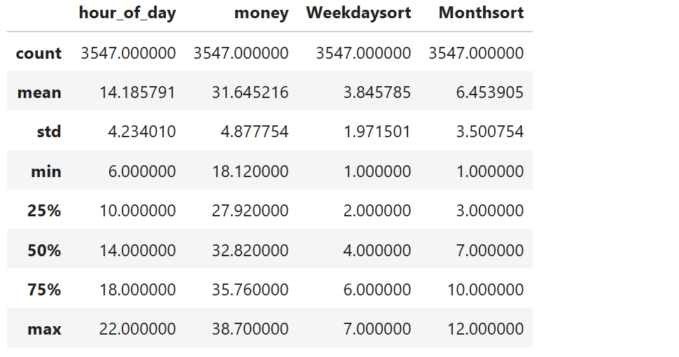
Code Academy
DATA CLEANING & PREPROCESSING
Handled missing values and removed unnecessary columns.
• Used .info() and .describe() to understand the dataset.
• Found averages, maximums, and minimums of numeric columns.
• Filtered data using .loc[], .isin(), and .between().
• Grouped data using groupby() to find average revenue by coffee name.
“we cleaned the data and used different Pandas methods to analyze sales performance by coffee name”

Slide 4
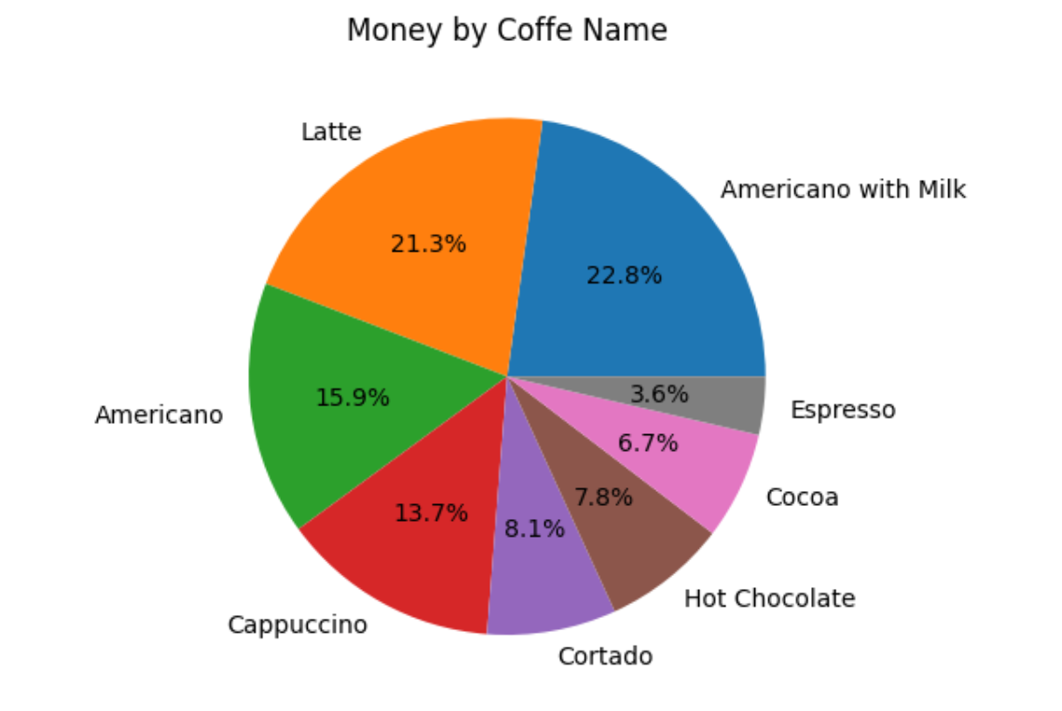
Code Acadwmy
DATA VISUALIZATION
• Line Plot: Shows sales trend over time.
• Bar Chart: Compares average revenue by coffee name.
•Histogram – Displays distribution of total revenue.
• Pie Chart: Displays coffee type sales share.
• Scatter Plot: Shows relationship between hour of day and money.
• Box Plot: Reveals revenue spread and outliers.
• Heatmap: Shows correlation between numeric columns.

Slide 5

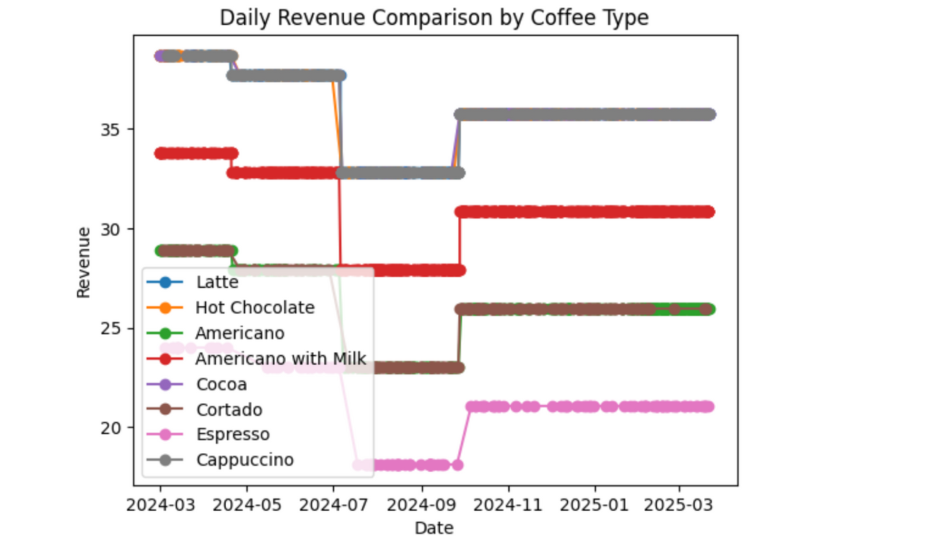
Code Academy
INSIGHTS & STORY FROM THE DATA
Latte and Cappuccino were the top-selling coffee name.
- The Downtown branch achieved the highest total sales.
- Weekend sales were higher than weekdays.
- Most sales ranged over than 35.
- A clear increase in sales was observed the beginning of the month due to promotions.

Slide 6

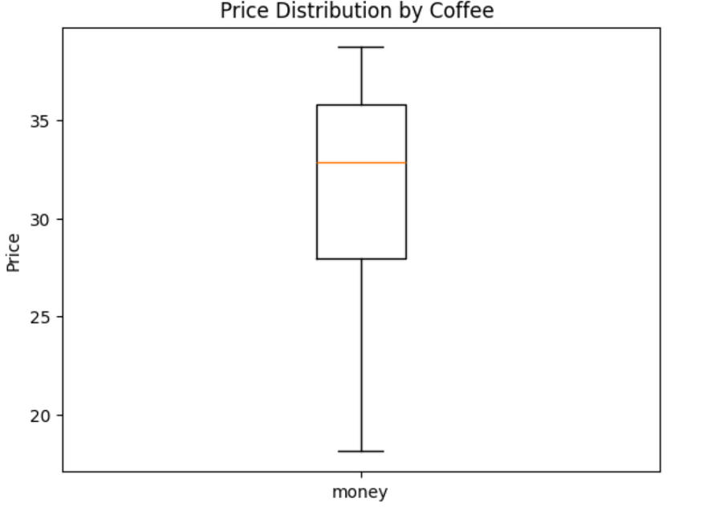
Code Academy
CONCLUSION & REAL WORLD RECOMMENDATIONS
• Managers can plan weekend promotions to increase sales.
• Inventory teams can stock up on popular items like Latte and Cappuccino.
• Marketing can focus on top-performing coffee types.
• Data insights help improve business performance and decision-making.

